Slide 1
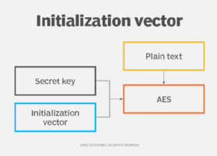
Cipher project
Program is going to read the files, encrypt it and return the keys to decrypt it.
Made by: Ilia Chistov

Slide 2
Technologies, Libraries
IDE: Visual Studio Code
Language: Java
Libraries: javax.crypto, java.io, java.util
Source: https://docs.oracle.com/

Slide 3
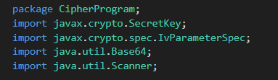
Main class

Slide 4
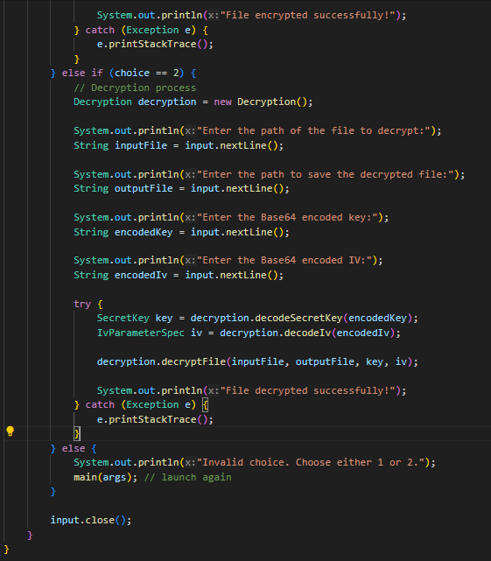
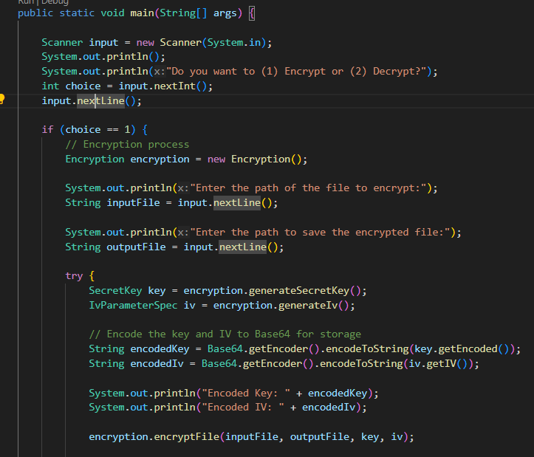
Main class

Slide 5
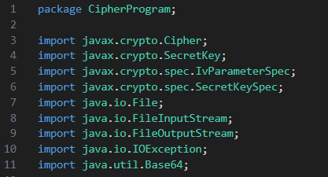
Decryption class

Slide 6
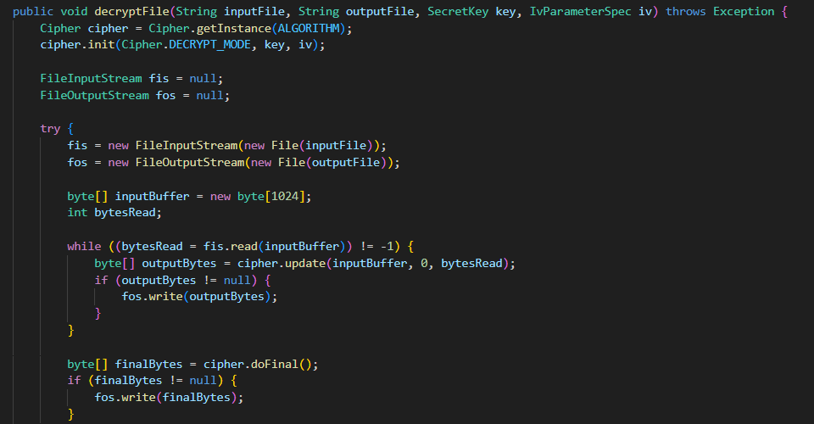
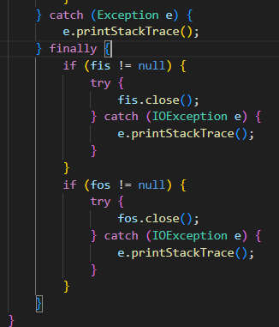
Decryption class

Slide 7
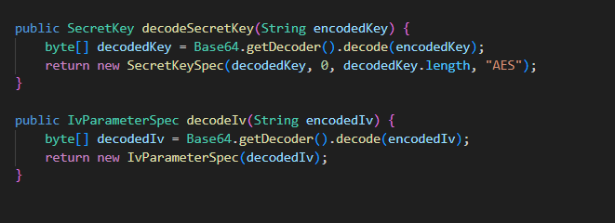
Decryption class

Slide 8
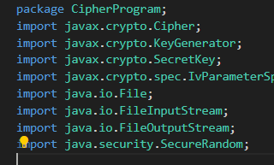
Decryption class

Slide 9
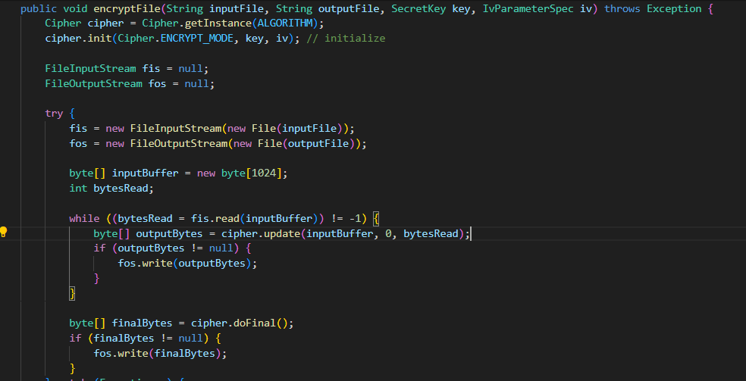
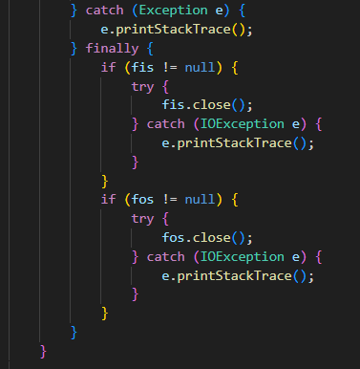
Encryption class

Slide 10
Encryption class

Slide 11
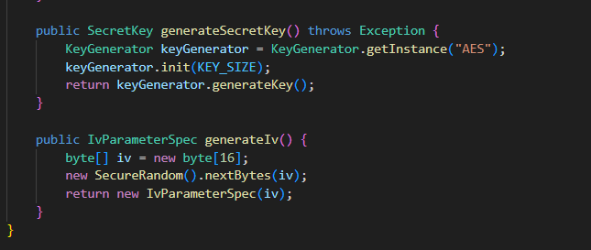
Encryption class

Slide 12
Let’s test it!

